Slide 1
Chapter 3 Getting Started with Kubernetes

Slide 2
Learning Topics
Overview of Kubernetes
Kubernetes Architecture
Key Components
Key Terminologies
Dashboard Walkthrough
Deploy Apps Through Dashboard

Slide 3
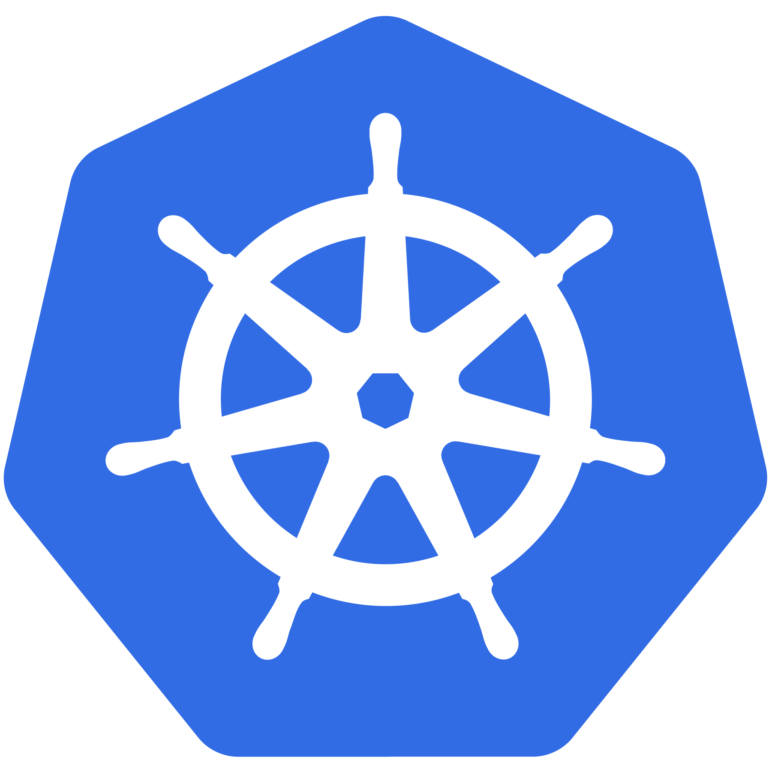
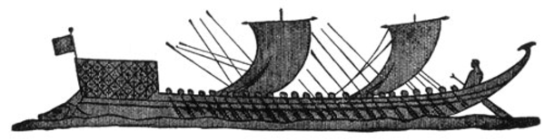
Kubernetes Meaning
Greek for “pilot” or
“Helmsman of a ship”

Slide 4
K8s History
Project that was spun out of Google as an open source container orchestration platform.
Built from the lessons learned in the experiences of developing and running Google’s Borg and Omega.
Designed from the ground-up as a loosely coupled collection of components centered around deploying, maintaining and scaling workloads.

Slide 5
K8s History
Contributors include Google, CodeOS, Redhat, Mesosphere, Microsoft, HP, IBM, VMWare, Pivotal, SaltStack etc.
Kubernetes is loosely coupled, meaning that all the components have little knowledge of each other and function independently.
This makes them easy to replace and integrate with a wide variety of systems
Written in Go Language

Slide 6

Who Manages Kubernetes
Sub-Foundation of Linux Foundation
A Vendor Neutral Entity to Manage “Cloud Native” Projects
Focused on
Containers
Dynamic Orchestration
Many More Services

Slide 7
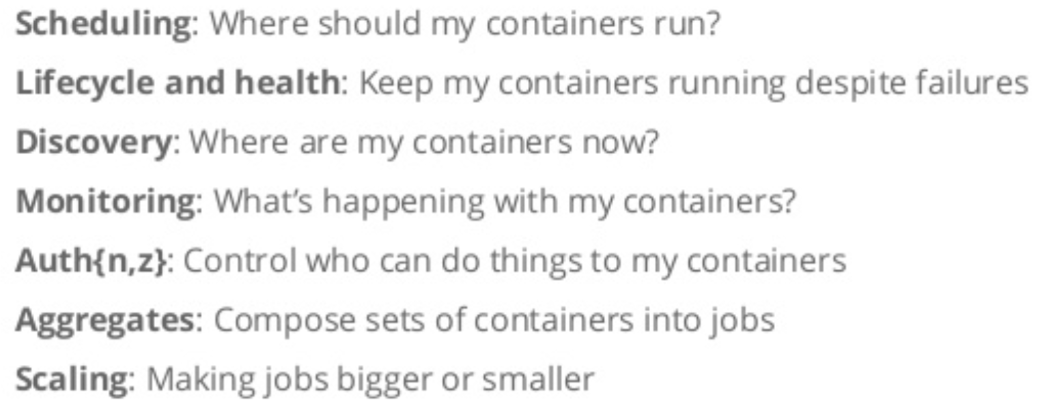
Container Issues

Slide 8
What Does Kubernetes Do?
Groups containers that make up an application into logical units for easy management and discovery
It acts as an engine for resolving state by converging actual and the desired state of the system
It is declarative, you tell it what you want it to be, and it figures it out
e.g. ‘I want 3 instances of x’ and it just does it, if something dies, it brings it back to get to 3

Slide 9
Most Popular Use Cases
Autoscale Workloads
Blue/Green Deployments
Scheduled Cronjobs
Manage Stateless and Stateful Applications
Easily Integrate and Support 3rd Party Apps
Provide Native Methods of Service Discovery

Slide 10
Kubernetes Features
Kubernetes is an open-source system for
Automating Deployment
Scaling
Management
of containerized applications
Kubernetes can scale without increasing your ops team

Slide 11
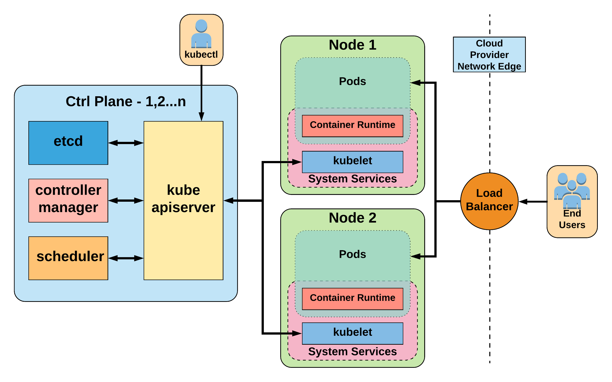
Kubernetes Architecture

Slide 12
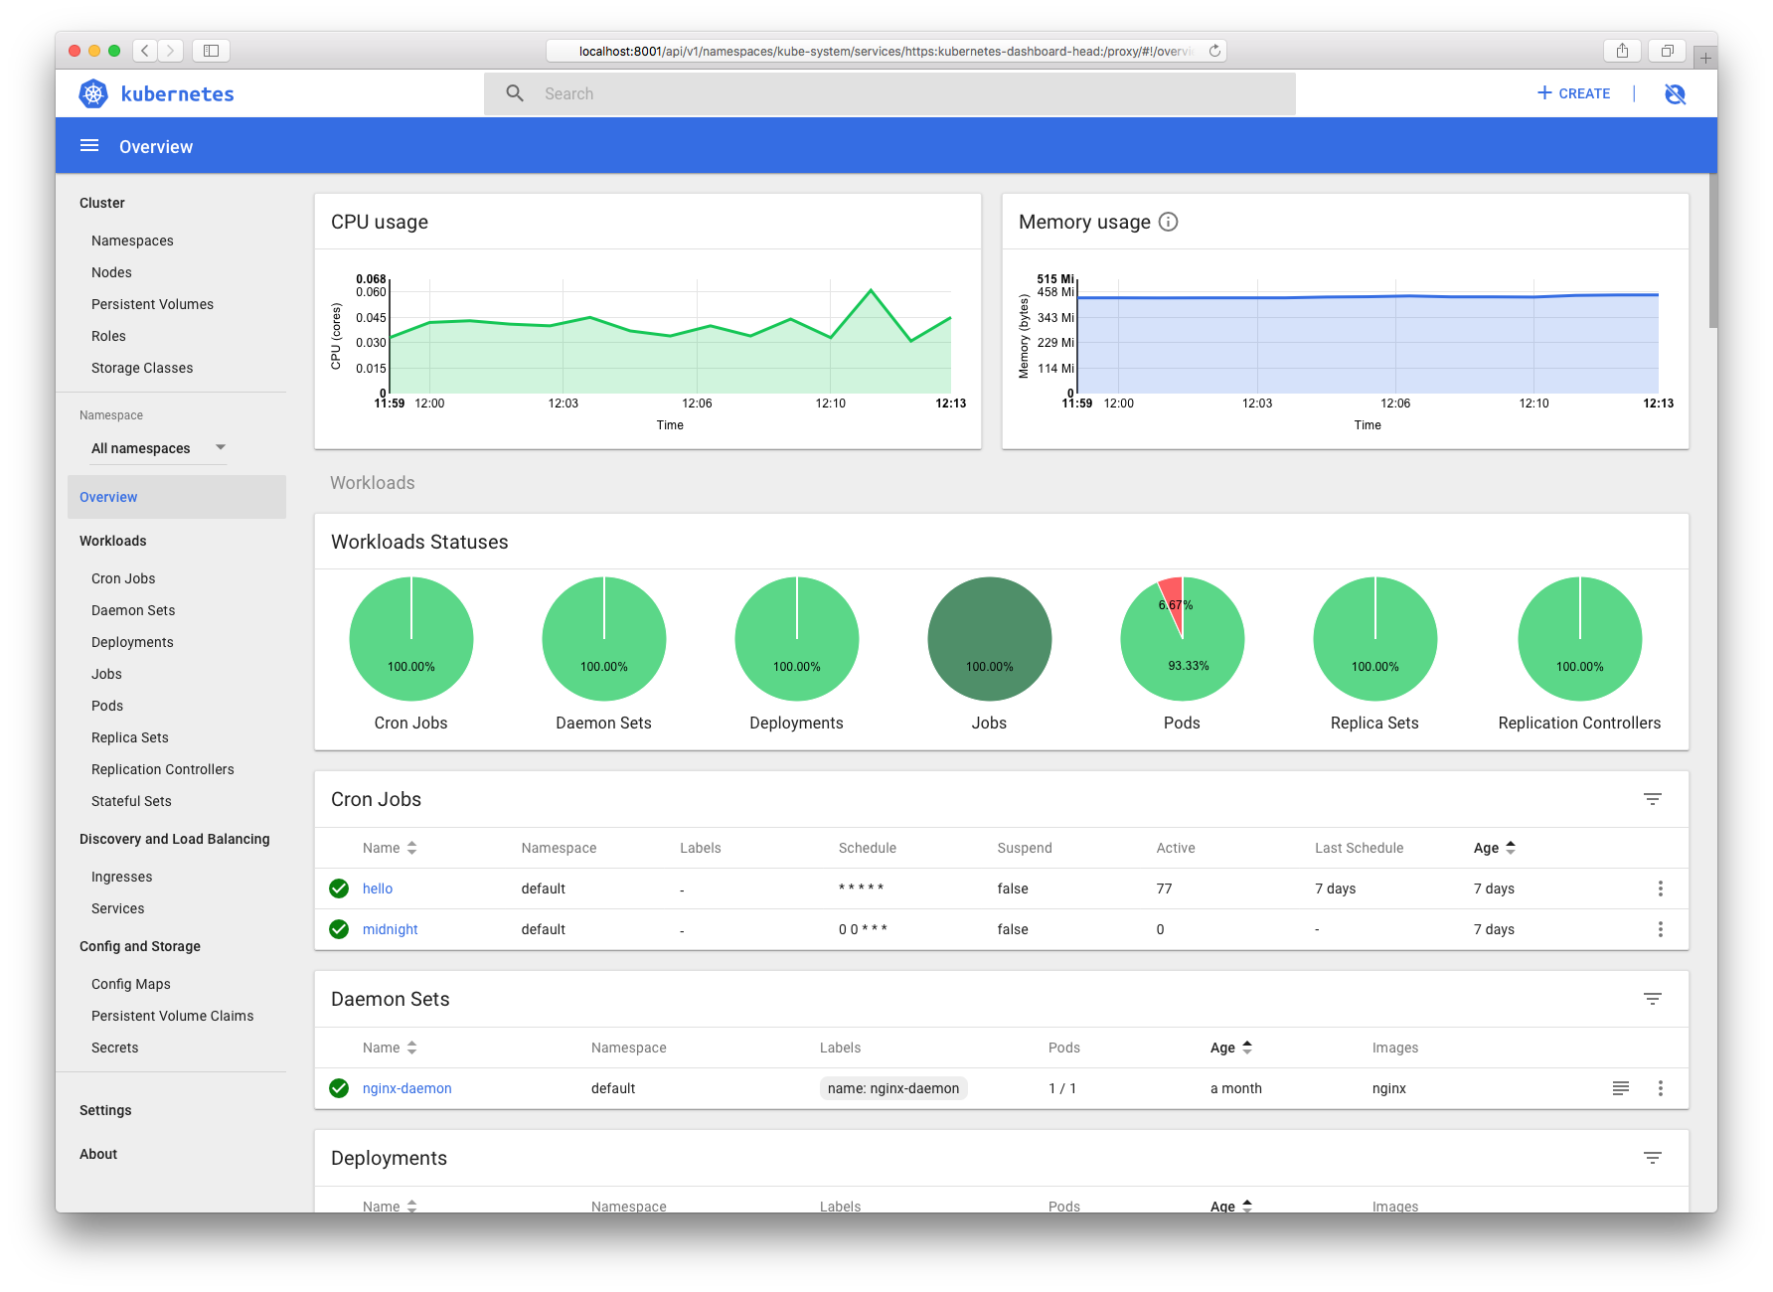
Lab 1 – Deploy NGINX App on K8 Cluster
Use Kubernetes Dashboard

Slide 13
Cluster Overview for Labs
Elastic Load Balancer (Cloud Provided)
3 Masters (Facilitates HA)
50 Nodes

Slide 14
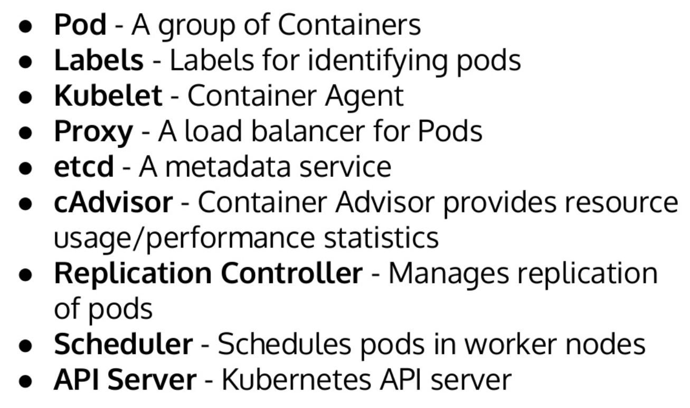
Key Terminologies

Slide 15
Pods
Smallest Unit of Work
Collection of One or More Containers
Share Volumes, Network Namespace
Part of Single Context, Managed Together
Ephemeral in Nature

Slide 16
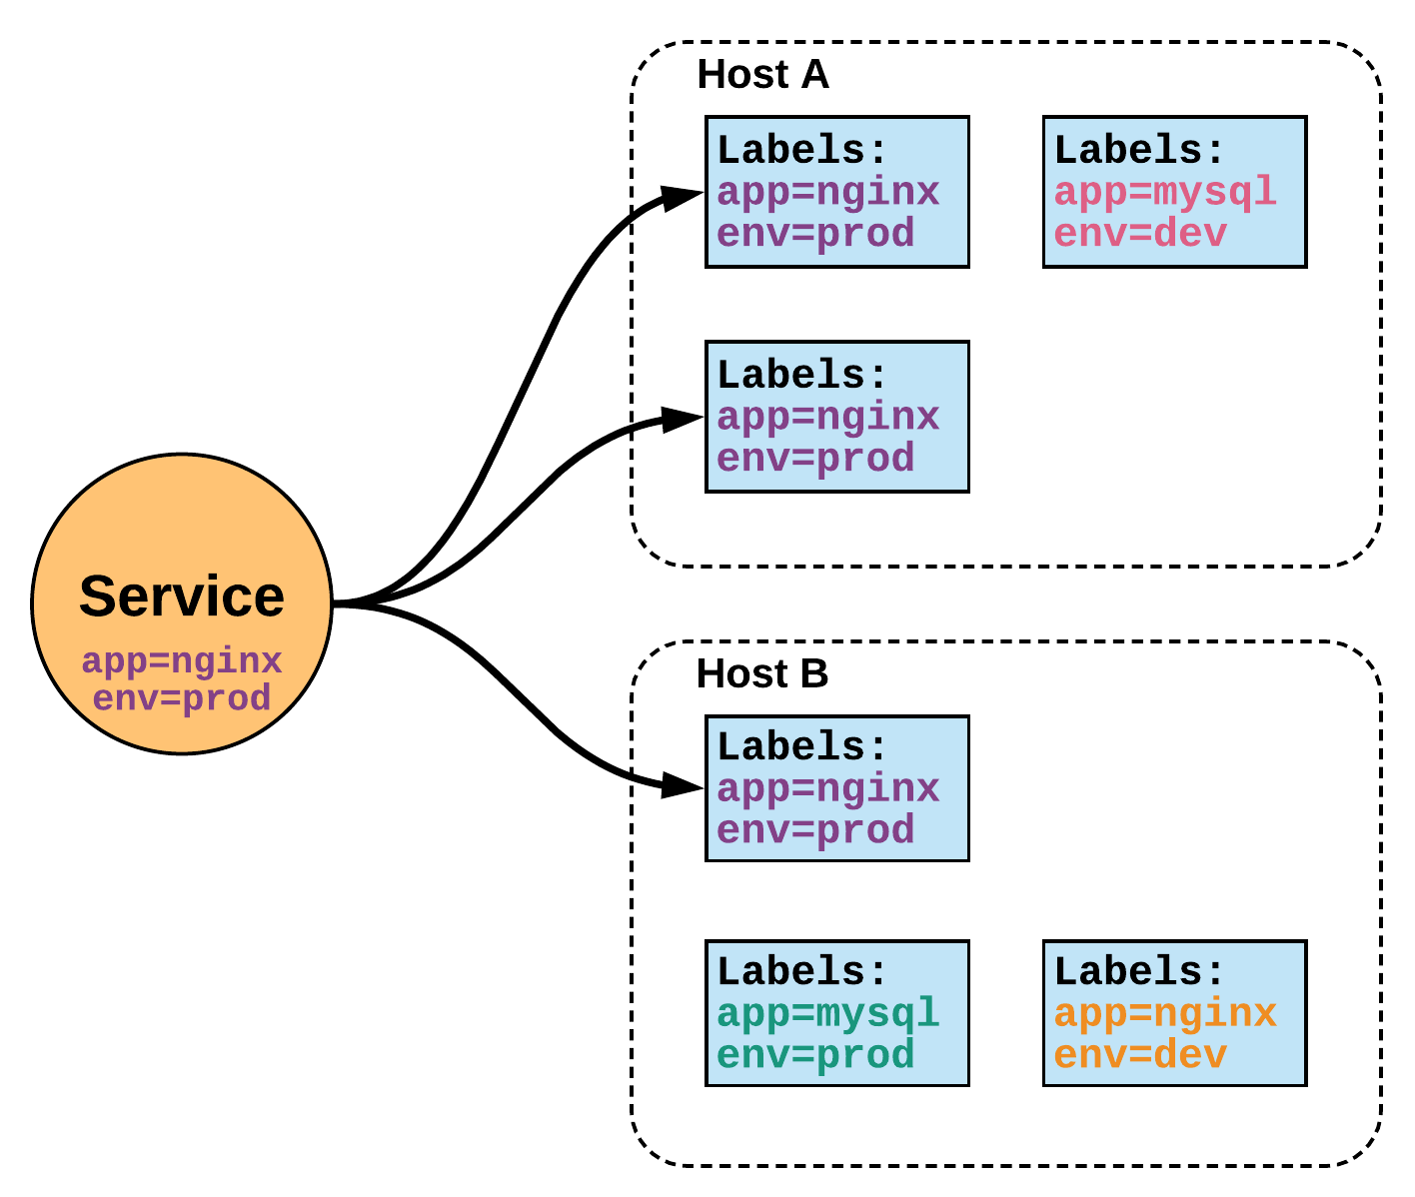
Services (Proxy)
Unified Method of Accessing Exposed Workloads of Pods
Internal Load Balancer to Your Pod(s)
Create a service, reference the pods, for e.g. 3, and (internally) it will load balance across the 3.
Durable Resource
Static Cluster IP

Slide 17
Control Plane Components
Kube-apiserver
Gate keeper for everything in kubernetes
EVERYTHING interacts with kubernetes through the apiserver
Etcd
Distributed storage back end for kubernetes
The apiserver is the only thing that talks to it
Kube-controller-manager
The home of the core controllers
Kube-scheduler
Handles placement

Slide 18
Kube-apiserver
Provides a forward facing REST interface into the kubernetes control plane and datastore.
All clients and other applications interact with kubernetes strictly through the API Server.
Handles authn, authz, request validation, mutation and admission control and serves as a generic front end to the backing datastore

Slide 19
etcd
etcd acts as the cluster datastore.
Purpose in relation to Kubernetes is to provide a strong, consistent, highly durable and highly available key-value store for persisting cluster state.
Stores objects and config information.

Slide 20
Kube-controller-manager
Its the director behind the scenes
Serves as the primary daemon that manages all core component control loops.
Monitors the cluster state via the apiserver and steers the cluster towards the desired state.
Does NOT handle scheduling, just decides what the desired state of the cluster should look like
e.g. receives request for a deployment, produces replicaset, then produces pods

Slide 21
Kube-scheduler
Scheduler decides which nodes should run which pods
Serves as the primary daemon that manages all core component control loops.
Monitors the cluster state via the apiserver and steers the cluster towards the desired state.
Does NOT handle scheduling, just decides what the desired state of the cluster should look like
e.g. receives request for a deployment, produces replicaset, then produces pods

Slide 22
Lab 2 – Scale Running Pods
Use Kubernetes Dashboard
Scale Your Existing NGINX App

Slide 23
Node Components
Kubelet
Agent running on every node, including the control plane
Kube-proxy
The network ‘plumber’ for Kubernetes services
Enables in-cluster load-balancing and service discovery
Container Runtime Engine
The containerizer itself - typically docker

Slide 24
Kubelet
Acts as the node agent responsible for managing the lifecycle of every pod on its host.
Kubelet understands YAML container manifests that it can read from several sources:
file path
HTTP Endpoint
etcd watch acting on any changes
HTTP Server mode accepting container manifests over a simple API.
The single host daemon required for a being a part of a kubernetes cluster

Slide 25
Kube-proxy
Manages the network rules on each node.
Performs connection forwarding or load balancing for Kubernetes cluster services.
Creates the rules on the host to map and expose services
Available Proxy Modes:
Userspace
iptables
ipvs (default if supported)

Slide 26
Container Runtime Engine
A container runtime is a CRI (Container Runtime Interface) compatible application that executes and manages containers.
Containerd (docker)
Kubernetes functions with multiple different containerizers
Interacts with them through the CRI - container runtime interface
CRI creates a ‘shim’ to talk between kubelet and the container runtime

Slide 27
Lab 3 – Deploy & Expose App
Use CLI for Deployment

Slide 28
This concludes Chapter 3 Getting Started with Kubernetes

